Slide 1
Eighth Grade Session 5
The Six Vocabulary Cheats

Slide 2
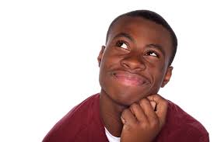
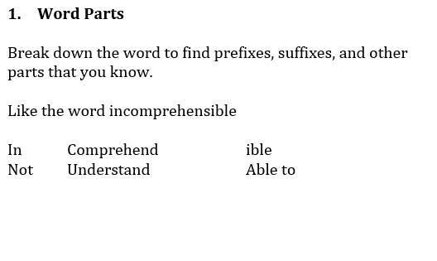
1. Word Parts
Ask yourself…
How can I break this word down?
What do the parts tell me about the
meaning and part of speech?
Notes:
Review the information on the slide then ask students for some of the words from Sonnet 18 that have word parts: dim’d, untrimm’d, grow’st
Now we are going to answer and FSA-style question using this information.

Slide 3
1. Word Parts
Read the following lines from the poem.
4 And summer's lease hath all too short a date:
5 Sometime too hot the eye of heaven shines,
6 And often is his gold complexion dimm'd;
What does the word dimm’d suggest in the Sonnet?
A. Summer is too splendid to be compared at all
B. The author’s love is brighter than any earthly object
C. The light from the summer sun eventually darkens
D. Gold is not worth as much as the author’s love
Notes:
Notice that it is not asking you to just understand what the word means, but the effect on the meaning.
Answer: C the word in question is dimmed, you can also use a contrast clue---dim is the opposite of shines in the line above.

Slide 4
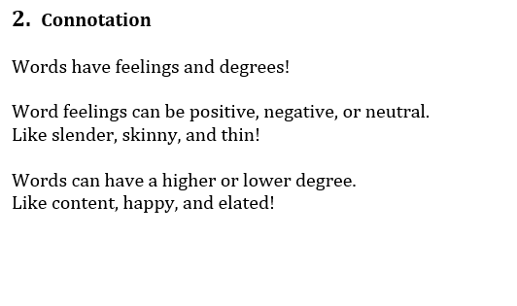
2. Connotation and Degree
Ask yourself…
Does the word have a positive, negative, or neutral feeling?
Is it mild or strong?
Notes:
Discuss the information on this slide. What are some words that have an emotional charge? Most poems and complex literature have shifts in tone. Since this Sonnet is a comparison, determine the connotation of the two things being compared: the love interest –positive, Summer Day- negative
Determine some of the words that help to develop the tone and note where the shifts are.

Slide 5
2. Connotation and Degree
Read the following line from the poem.
5 Sometime too hot the eye of heaven shines,
What is suggested by the phrase hot the eye of heaven shines?
A. Everyone loves the warm summer sun
B. The author’s love interest is very attractive
C. The woman described is hotter than the sun
D. The sun can sometimes be overwhelming
Notes:
Correct answer: D We know that we are looking for a negative connotation ask students to tell the word with a negative connotation in the answer and the connotation of the distractors.
Note that the eye of heaven is referring to the sun, not the woman being described.

Slide 6
3. Context Clues
Ask yourself…
What signal words do I see?
How can the main idea help me?
Notes:
Discuss what each means and the results of each…

Slide 7
3. Context Clues
Part A: Read the following lines from Sonnet 18.
7 And every fair from fair sometime declines, 8 By chance, or nature's changing course, untrimm'd;
9 But thy eternal summer shall not fade
What does the word eternal suggest?
A. The woman’s beauty will never diminish
B. This summer feels like it is lasting forever
C. The woman is more beautiful than the sun
D. The summer days are getting longer and longer
Part B: Select the words and phrases in lines 7-9 that provide evidence for your answer in Part A.
Notes:
Correct answer: A
The words shall not fade are a synonym clue and the word declines is an antonym clue for the word diminish in the correct answer.

Slide 8
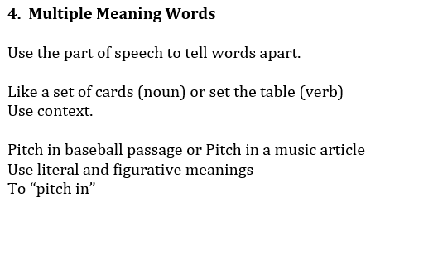
4. Multiple Meaning Words
Ask yourself…
What is the part of speech?
What context is the word being used?
Is it used figuratively or literally?
How can I break this word down?
What do the parts tell me about the
meaning and part of speech?
Notes:
Discuss what each means and the results of each…

Slide 9
4. Multiple Meaning Words
Read the line below from Sonnet 18.
7 And every fair from fair sometime declines,
What does the word fair refer to in the sonnet?
A. Beautiful things
B. Light coloring
C. Ordinary objects
D. Festival items
Notes:
Correct answer: A

Slide 10
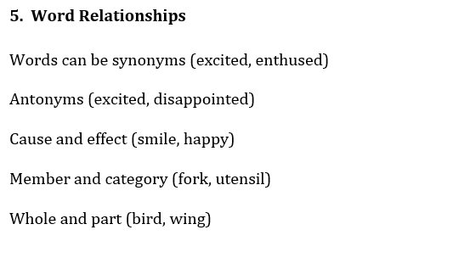
5. Word Relationships
Ask yourself…
Are these words synonyms or antonyms?
Are they related by cause/effect, whole/part,
category/ member?
How can I break this word down?
What do the parts tell me about the
meaning and part of speech?
Notes:
Discuss what each means and the results of each…

Slide 11
5. Word Relationships
Read the following lines from the poem.
10 Nor lose possession of that fair thou ow'st;
11 Nor shall Death brag thou wander'st in his shade,
The author uses the word nor to show
A. Cause and effect
B. Sequence
C. Similarities
D. Contrast
.
Notes:
Correct answer: D

Slide 12
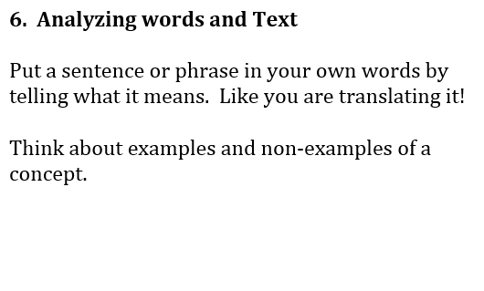
6. Analyzing Words and Text
Ask yourself…
How can I simplify this sentence?
What transitions do I see?
How can I restate in my own words?
How can I break this word down?
What do the parts tell me about the
meaning and part of speech?
Notes:
Discuss what each means and the results of each…

Slide 13
6. Analyzing Words and Text
Read this excerpt from the poem.
11 Nor shall Death brag thou wander'st in his shade,
What is the effect of the personification in line 11?
A. It shows that the author wants to protect his love
B. It implies that the author’s love interest will never die
C. It explains why the author’s love for her will never end
D. It illustrates the point that the season will last forever
Notes:
Answer: B

